Slide 1
Case Study 3&4
201533668 장정익
201533669 정동윤
201635848 장휘준
201735872 장하영
201835514 장지아
201835519 전수환

Slide 2
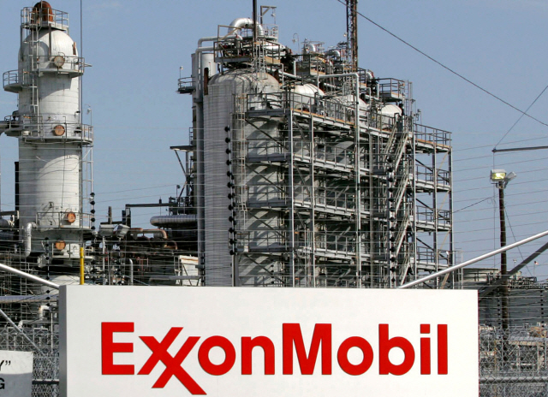


Contents 1
What was the Problem?
New Directors
Of the 12 Directors of Exxon Mobile, three newly appointed consist of directors nominated by Engine No. 1
This is due to ExxonMobil’s record deficit and insufficient investment in alternative energy

Slide 3
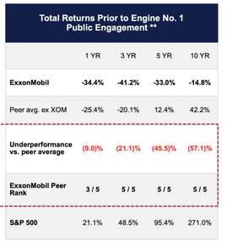
Contents 2
Engine no.1’s strategy – Reenergize Exxon Campaign
1st strategy –
Targeting the financial income side
Over the past decade, ExxonMobil’s total shareholder return was (-)14.8%, while its fellow companies’ shareholder return was (+)271%.
Notes:
Engine no.1의 전략 – Reenergize Exxon Campaign, 권고안, 이사진 교체
# S&P 500(Standard & Poor’s 500 Stock Index): 500개 대형기업의 주식을 포함한 지수

Slide 4


Contents 2
Engine no.1’s strategy – Reenergize Exxon Campaign
New board of directors
Reinforcement capital allocation rules
Strategic plan execution
Management incentive adjustment
2nd strategy –
Four recommendations
3rd strategy –
Changing the board of directors
Notes:
Engine no.1의 전략 – 재무수익 측면 공략, 권고안, 이사진 교체

Slide 5





Contents 3
How are they going?
This strategy of Engine no.1 drew positive responses from shareholders and led to CalSTRS support
"Engine No.1's strategy, which considers shareholders' ESG issues and financial returns, begins important changes that will lead to similar cases in the future."
Notes:
Reengeize Exxon Campaign

Slide 6

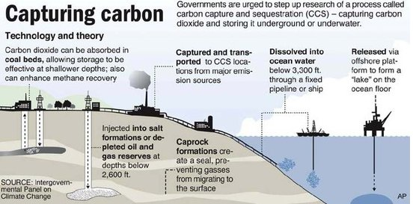
Contents 3
How are they going?
In March, a low-carbon countermeasure division was newly established
Enter the CCS(Carbon capture and storage) field in earnest
Notes:
결과 – 기후위기 대응을 보다 적극적으로 나서야 한다.

Slide 7
Thank you
Any question?

